Slide 1
HDI, SHR Design Concepts
Week 2 Deliverables
3.Jun.16
Juhan Sonin

Slide 2
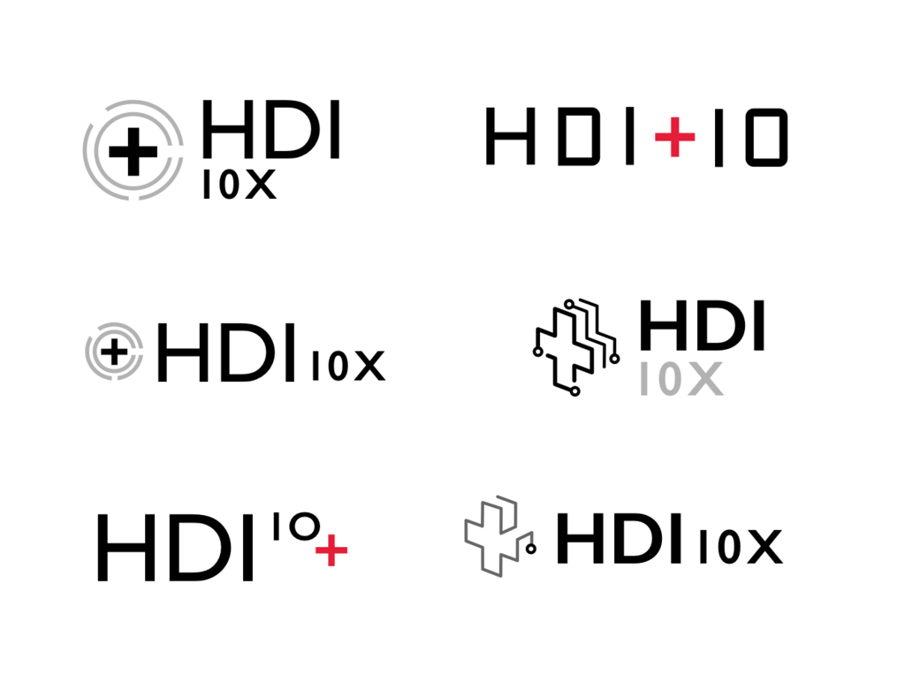
HDI Logo v.01
1
4
2
5
3
6
Notes:
HDI needs a family of logos versus 1… to accomodate the suite of projects

Slide 3
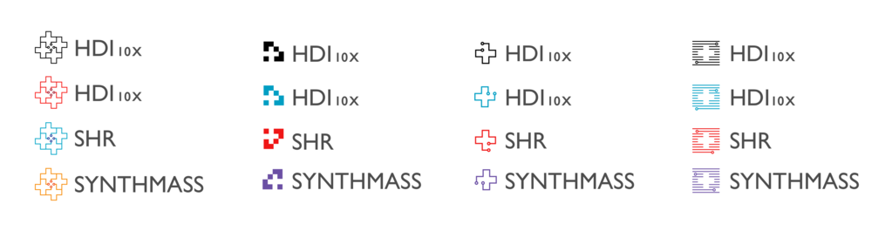
HDI Logo v.02
7
8
9
10
Notes:
Not enough differentiation

Slide 4
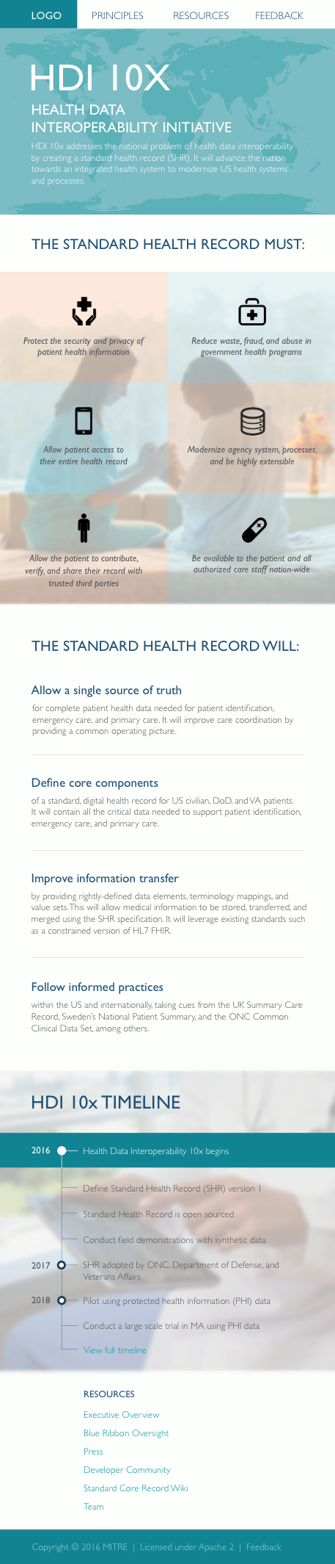
HDI Mobile Website v.01
Notes:
For details, see shr_website_mobile_v1.pdf

Slide 5


SHR View v.01
Mobile click-through
(try on mobile device):
http://adobe.ly/1TYy2jR
Notes:
For mobile prototype, use on your phone: http://adobe.ly/1TYy2jR

Slide 6
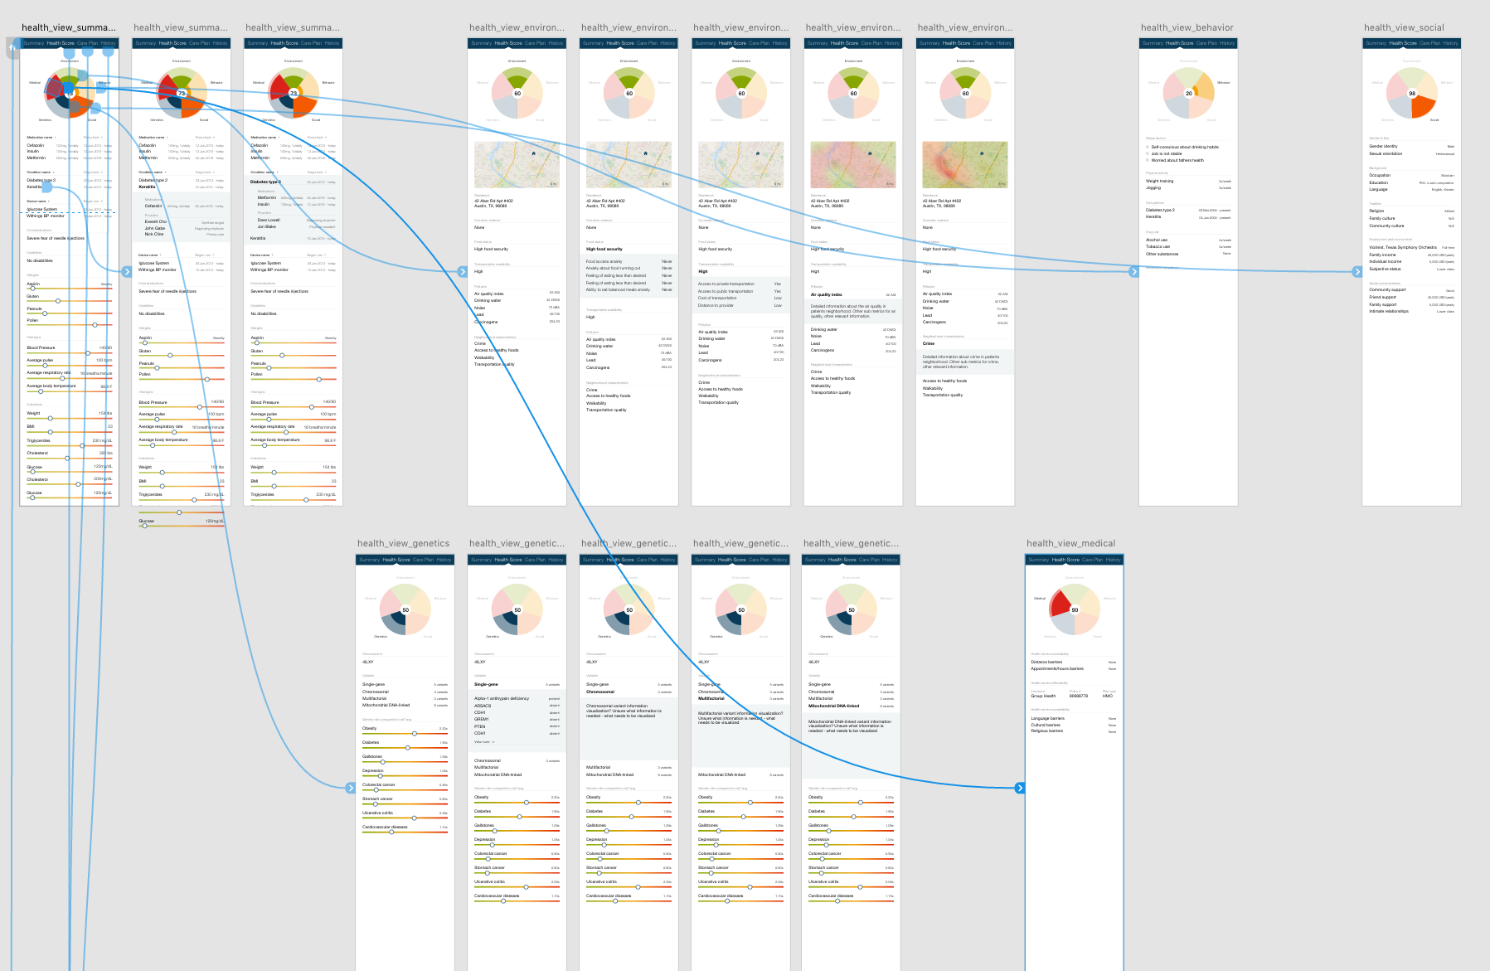
SHR Clinician View v.01
Notes:
Trying out Adobe’s XD product (Experience Design)

Slide 7
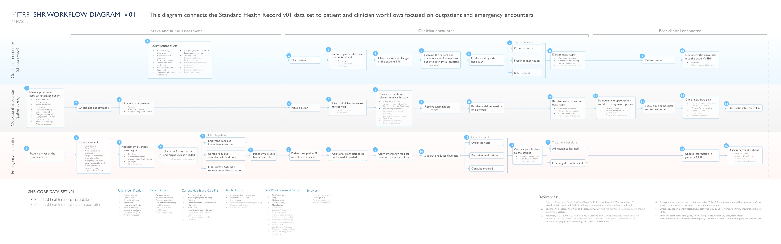
SHR Workflow v.01 (26.May.16)
View SHR_workflow_v01.pdf for details
Notes:
View shr_workflow_v01.pdf for details

